Slide 1
EMPIRICAL EVALUATION OF THE TARANTULA AUTOMATIC FAULT-LOCALIZATION TECHNIQUE
AUTHORS:
JAMES A. JONES
&
MARY JEAN HARROLD
Jayasurya Pazhani - 40289512

Slide 2
Introduction
Fault localization is the process of identifying the faulty parts of a program by analyzing the results of executed test cases.
The goal is to reduce the time it takes for developers to identify and fix bugs by using automated tools.
Several techniques are used for fault localization, including statistical methods like Tarantula.
Notes:
Fault localization is a critical process in software development. It involves identifying which parts of the program are likely to contain errors, based on the results of test cases. As programs become more complex, manually finding bugs can become time-consuming and error-prone. This is where fault localization tools come in.
The main objective of fault localization is to help developers pinpoint bugs faster, which ultimately improves the efficiency of the development process. There are various techniques available for fault localization, each with its own strengths and weaknesses.
Today, we’ll look at a technique called Tarantula, a statistical method that ranks program statements based on their likelihood of containing errors, making it easier for developers to find and fix bugs. We’ll look at how this technique compares to others and why it might be a better choice for some scenarios.

Slide 3
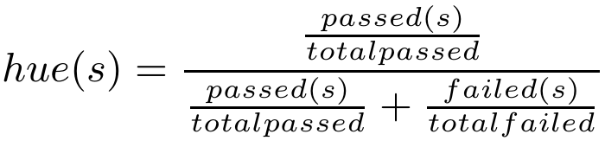
What is Tarantula?
Tarantula is a fault-localization tool that uses test results to rank program statements based on how likely they are to contain errors.
Statements run more often by failed test cases are considered more suspicious.
Visualization:
Red: High suspicion of error.
Yellow: Medium suspicion.
Green: Low suspicion.
Notes:
Tarantula is a tool that helps programmers find bugs in their code more easily. It looks at test results to figure out which parts of the code are more likely to have problems.
The main idea is simple: if a statement in the code is run mostly by failed tests, it’s more likely to be the cause of the problem. If the statement is run by both passing and failing tests, it’s less suspicious.
The formula here calculates a value for each statement based on how often it is run by passing and failing tests. This value is used to decide how suspicious the statement is.
To make it easier to understand, Tarantula shows the results as colors. Statements that are likely to be faulty are shown in red. Statements with a mix of passing and failing tests are yellow, and statements run mostly by passing tests are green.
Let’s take a simple example. Imagine a login form with two checks—one for the username and one for the password. If most failed tests run the password check, Tarantula will highlight that part of the code in red. This helps the programmer know where to look first, saving time and effort.
Overall, Tarantula helps programmers focus on the parts of their code that are most likely to have errors, making debugging faster and easier.

Slide 4
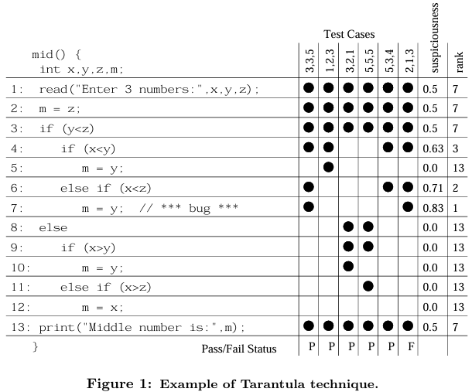
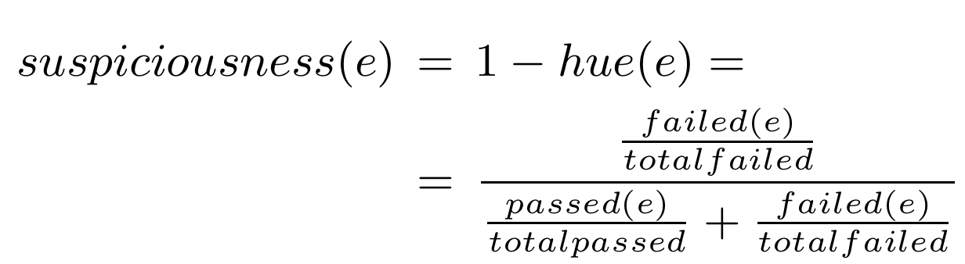
How Tarantula works?
Tarantula uses test results to calculate how suspicious each line of code is.
This simple code takes three numbers as input and prints the middle number. There is a bug at line 7: the line should assign m = x; instead of m = y;
Notes:
Tarantula uses test results to calculate how suspicious each line of code is. The table shows test case inputs, whether they passed or failed, the suspiciousness scores for each line, and their rank. The higher the suspiciousness score, the more likely the line is to contain the bug.
This simple code takes three numbers as input and prints the middle number. There is a bug at line 7: the line should assign m = x; instead of m = y;.
The suspiciousness is calculated using this formula, which compares how often a statement is executed by both passing and failing tests. For example, if a statement is executed mostly by failed tests, its suspiciousness score will be higher.
In this example, Tarantula assigns a high suspiciousness score of 0.71 to line 7 because it’s executed by the failed test case. Line 7 is ranked 2, which means it’s one of the first lines the programmer should check during debugging.
This process helps quickly pinpoint likely errors in the code, saving time and effort during debugging.

Slide 5
Empirical Study
Objective: Compare Tarantula to four other fault-localization techniques.
Techniques Compared:
Set Union
Set Intersection
Nearest Neighbor
Cause Transitions
Evaluation Criteria:
Effectiveness: How accurately each technique locates faults.
Efficiency: The speed at which each technique performs fault localization.
Notes:
The primary purpose of this study is to compare Tarantula with four other fault-localization techniques to assess their effectiveness and efficiency. Fault localization is a key aspect of debugging, helping developers identify the sections of code that are most likely to be causing errors.
The techniques being compared are:
Set Union: A technique that combines the information from failing test cases.
Set Intersection: This method identifies common elements between failing and passing test cases.
Nearest Neighbor: Uses similarities between test cases to locate faults.
Cause Transitions: Focuses on identifying changes in behavior that lead to failures.
The evaluation is based on two main criteria:
Effectiveness, or how accurately the technique can identify the faulty code.
Efficiency, or how quickly it can perform the fault localization.
The goal is to understand which of these techniques works best under real-world conditions, with a particular focus on Tarantula due to its unique approach and potential for improving debugging workflows.

Slide 6
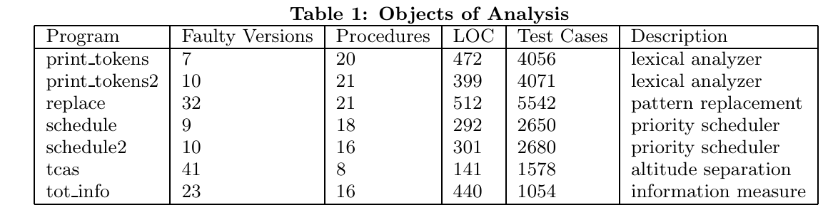
Experimental Setup
Programs Used: Siemens suite, consisting of 7 programs with 132 faulty versions in total.
Includes programs like lexical analyzers, schedulers, and replacements.
Test Cases: Designed to cover all paths within the programs to thoroughly test their functionality.
Notes:
The suite includes 7 different programs, with a total of 132 versions that each contain a single fault. These programs are a mix of lexical analyzers, schedulers, and replacement tasks.
The test cases were designed to ensure that all possible paths in the program were tested, giving us comprehensive coverage to evaluate how well each fault-localization technique works.
One important detail is that each program version contains only one fault, which makes the results easier to interpret. This design choice allows us to compare the fault-localization methods in a controlled setting, as each technique has only one error to locate in each program version.

Slide 7
Fault-Localization Techniques Comparison
Set Union: Compares the difference between the test coverage of passed and failed tests to identify suspicious code.
Set Intersection: Looks at the intersection of statements executed by all passed tests but not by failed tests to detect faults.
Nearest Neighbor: Identifies the passed test that most resembles the failed test and eliminates matching statements to focus on faults.
Cause Transitions: Focuses on memory state transitions to pinpoint likely locations of faults.
Notes:
In this study, several fault-localization techniques has compared, each using a unique approach to identify potential faults in the code:
Set Union looks at the difference in test coverage between passed and failed tests, highlighting parts of the code where there is a discrepancy between the two.
Set Intersection takes a different approach by focusing on the intersection of statements executed by passed tests but not by failed ones, suggesting those areas are less likely to contain faults.
Nearest Neighbor works by finding a passed test that is most similar to the failed one. It removes any statements that are common between the two tests, allowing us to focus on the differences and potential fault areas.
Cause Transitions leverages the concept of memory state transitions, analyzing how the program's memory changes between test states to identify areas most likely to be responsible for the fault.
Each of these techniques has different strengths and weaknesses in terms of how they tolerate errors in passed tests and the level of precision they offer in identifying faults.

Slide 8
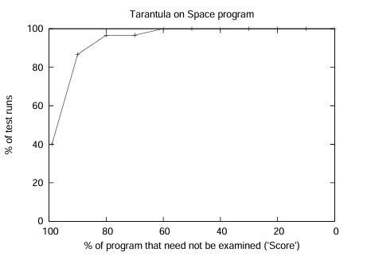
Dependent and Independent Variable
Independent Variable: Fault-localization technique used (Tarantula, Set Union, Set Intersection, Nearest Neighbor, Cause Transitions).
Dependent Variables:
Effectiveness: Percentage of code not examined before the fault was found.
Efficiency: Time taken for computation and I/O processes.
Notes:
In the experimental design, two key aspects were focused: effectiveness and efficiency.
The independent variable in this study is the fault-localization technique used. The authors compared five techniques: Tarantula, Set Union, Set Intersection, Nearest Neighbor, and Cause Transitions.
then measured the dependent variables:
Effectiveness was determined by how much of the code could be ignored before the fault was identified. The higher the effectiveness, the less unnecessary code needs to be examined before the fault is located.
Efficiency was assessed by looking at how long the technique took in terms of computation and input/output processes. This helped us understand the resource usage and time efficiency of each method.

Slide 9
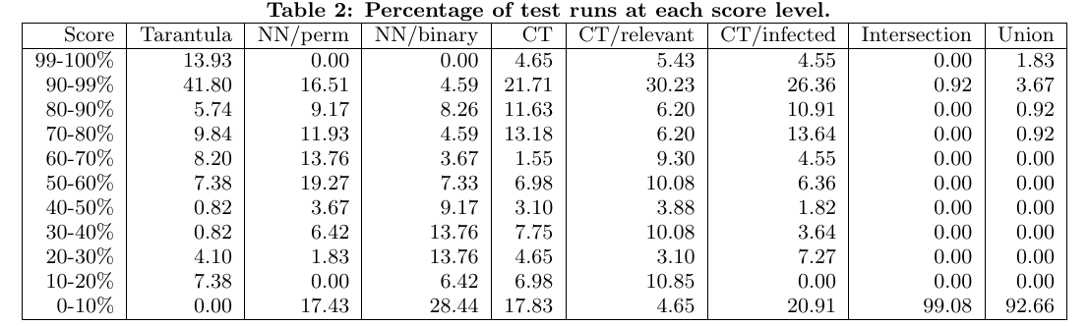
Effectiveness comparison by Score
Tarantula's Performance:
At 99% score level: Tarantula pinpointed faults in 13.9% of runs.
At 90-99% score level: Tarantula located faults in 41.8% of runs.
Graph: % of runs vs. % of program not examined (showing comparison between Tarantula and other techniques).
Notes:
In terms of effectiveness, Tarantula outperformed all other techniques, consistently identifying faults more efficiently.
At the 99% score level, Tarantula pinpointed faults in 13.9% of the test runs, which means it was able to narrow down the problematic code to a small portion of the program with a very high level of confidence.
Even at the 90-99% score level, where the precision is slightly lower, Tarantula still performed impressively, identifying faults in 41.8% of the runs.
We can see from the graph that, as we increase the score level, Tarantula consistently identifies faults with fewer lines of code to examine, making it a highly effective technique. In fact, at the highest precision level, it pinpointed faults three times more often than the next-best technique, demonstrating its superior performance across various scenarios.

Slide 10
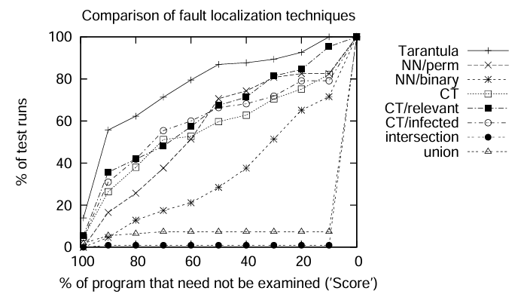
Effectiveness Graph
Visual representation comparing Tarantula with other techniques across various score levels.
Tarantula has the highest percentage of high scores in identifying faults.
Notes:
This chart provides a visual comparison of how each fault-localization technique performs across different score levels. As you can see, Tarantula consistently achieves the highest percentage of high scores. This indicates that it is more effective at identifying faults with a higher degree of precision compared to the other techniques.
At higher score levels, the percentage of runs where faults are found quickly is significantly greater for Tarantula, further emphasizing its superiority in fault localization. This confirms that Tarantula is not only efficient but also highly effective in narrowing down problematic parts of the code

Slide 11
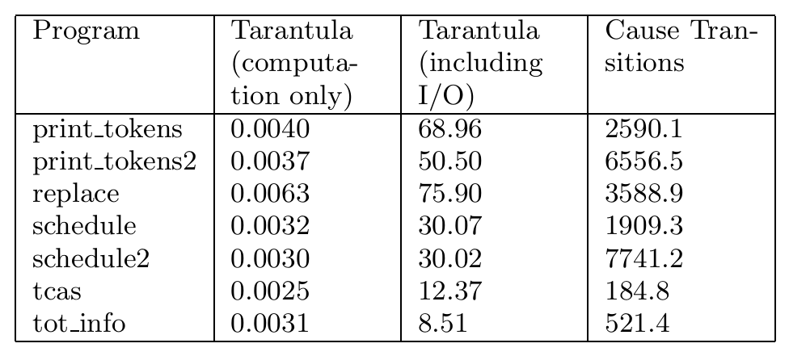
Efficiency comparison
Tarantula Computation Time: 0.0025–0.0063 seconds.
Cause Transitions Time: 180–6500 seconds.
Tarantula’s Efficiency Advantage: Two orders of magnitude faster than Cause Transitions.
Notes:
When we look at efficiency, the difference between Tarantula and Cause Transitions is quite striking. Tarantula takes only 0.0025 to 0.0063 seconds to complete the fault-localization process. In stark contrast, Cause Transitions takes anywhere from 180 to 6500 seconds—significantly slower.
This dramatic difference means that Tarantula is two orders of magnitude faster than Cause Transitions, making it an ideal choice for large-scale debugging tasks. The speed of Tarantula allows it to quickly pinpoint faults, making the debugging process much more efficient, especially in projects with a large amount of code and multiple test cases.

Slide 12
Why Tarantula succeeds
Comprehensive Test Data: Leverages diverse test cases to improve accuracy.
Tolerance for Passing Errors: Doesn't over-penalize statements covered by passing tests.
Visualization: Offers an easy-to-understand, color-coded view to highlight suspicious statements.
Notes:
Tarantula stands out because it strikes a balance between comprehensive test data and flexibility in handling errors. By incorporating a variety of tests, Tarantula can more accurately assess which code statements are problematic.
Its tolerance for passing errors is another key factor in its success. Unlike other techniques that may flag a statement just because it appears in some passing tests, Tarantula doesn't overreact. It considers the overall picture, only focusing on the statements that seem suspicious due to their high involvement in failed tests.
Finally, visualization plays a crucial role. The color-coded system, with red for high suspicion, yellow for moderate, and green for low suspicion, provides an intuitive way for programmers to identify where issues are most likely. This visualization is one of the main reasons Tarantula is so effective and easy to use for debugging.

Slide 13
Study Limitations
Limited to Single-Fault Scenarios: Focuses on programs with one fault per version.
Siemens Suite Programs: Small-scale programs, results may not generalize to larger systems.
No Real-World User Studies: Lack of practical user validation for the techniques.
Notes:
While this study provides valuable insights, it's important to recognize some limitations. First, it focuses solely on single-fault scenarios, which might not capture the complexities of real-world software with multiple interacting bugs.
The programs in the Siemens suite are relatively small and simple, which may limit the generalizability of the results. Larger, more complex programs could yield different outcomes, especially in terms of fault localization effectiveness and efficiency.
Lastly, the study didn't include real-world user studies. This means we don't know how these techniques would perform when developers are actually using them in a live setting with their own codebases. So, while the results are promising, further research is needed to test these techniques in more practical, varied environments

Slide 14
Summary of Findings
Tarantula's Superiority: Most effective and efficient fault-localization technique tested.
Performance: Outperforms all other techniques in precision and speed.
Higher Effectiveness: At 99% score level, Tarantula pinpointed faults in 13.9% of runs.
High Accuracy: Tarantula found faults in 41.8% of runs at 90-99% score level.
Speed Advantage: Tarantula is two orders of magnitude faster than Cause Transitions.
Test Data & Visualization: Comprehensive use of test data and visual representation aid in identifying suspicious code.
Tolerance for Passing Faults: Allows tolerance for faults in passing tests, improving robustness.
Notes:
In conclusion, Tarantula has demonstrated itself as the most effective and efficient fault-localization technique tested. It stands out for its ability to pinpoint faults quickly, especially at high precision levels. For instance, at a 99% score level, it successfully identified faults in 13.9% of runs, and at the 90-99% range, it located faults in 41.8% of runs. This makes Tarantula a powerful tool for programmers, helping them focus their efforts where they're most likely to find bugs.
Not only is Tarantula highly accurate, but it is also extremely fast—outperforming Cause Transitions by a factor of two orders of magnitude. This makes it ideal for large-scale debugging tasks where efficiency is key.
One of the reasons for its success is its ability to use comprehensive test data and visualizations, which make it much easier for developers to intuitively identify problematic parts of the code. Furthermore, Tarantula's approach of tolerating faults in passing tests gives it a robustness that other techniques lack.
Overall, Tarantula’s combination of accuracy, efficiency, and visual intuition make it an excellent choice for developers aiming to quickly and effectively identify and resolve bugs.

Slide 15
Thank You!
Jayasurya Pazhani
40289512

